Slide 1


Course Introduction
COM Programming
Notes:
Page <number>
WNCOMPG-2 v1.5
Chapter 1, Course Introduction

Slide 2
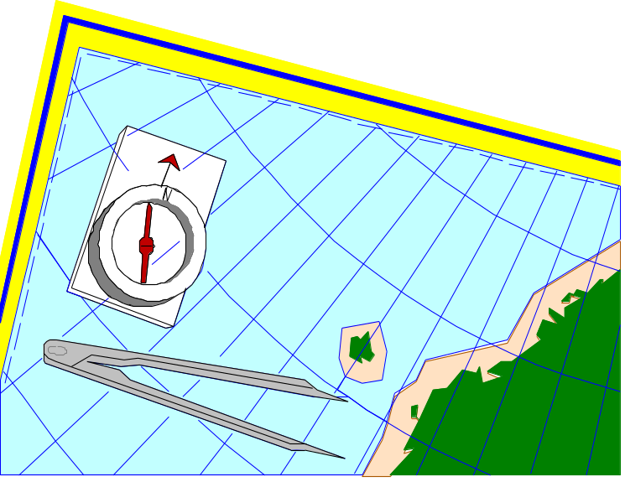


Course Introduction
Objectives
  To introduce the course
Contents
  Course objectives
  Course prerequisites
  Course delivery
  Course contents
Questions and introductions
Notes:
Page <number>
WNCOMPG-2 v1.5
Chapter 1, Course Introduction

Slide 3

Course Objectives
On completion of this course, you should be able to:
Describe the basic features of COM
Build a simple COM object from scratch
Define a COM interface using IDL
Build more-complex COM objects using ATL
Write COM clients in other languages
Implement callbacks using connection points
Appreciate the issues involved in DCOM
Describe the features of the COM+ environment
Notes:
Page <number>
WNCOMPG-2 v1.5
Chapter 1, Course Introduction

Slide 4
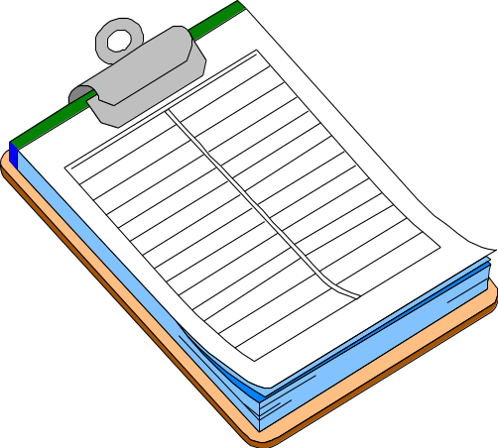
Course Prerequisites
Essential...
  Good working knowledge of object-oriented programming
  At least 6 months experience with C++
  At least 3 months experience in Win32 programming
Beneficial...
  Experience with Visual Basic
  Experience of developing client/server applications
  Familiarity with Microsoft Visual Studio
Notes:
Page <number>
WNCOMPG-2 v1.5
Chapter 1, Course Introduction

Slide 5
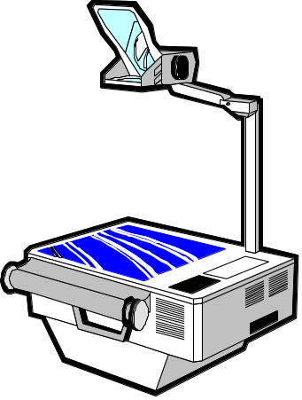
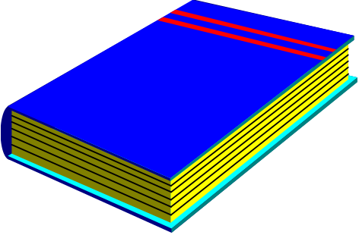


Course Delivery
Very Small
And Small Again
class nonsense
{
public: // sector
...
private: // parts
...
};
class nonsense
{
public: // sector
...
private: // parts
...
};
The PARTS Catalogue is the main source of Parts for your application. The Catalogue resembles a notebook control containing pages that can be accessed through the use of the tabs. There are both major and minor tabs. The major tabs are located along the right-hand side, and the minor tabs can be seen along the bottom edge. The minor tabs indicate that there are more pages for that particular major tab; there are different minor tabs for each major tab. Another way of turning through the pages, is to use the page control buttons. Notice that the page numbers change when you move between pages.
On the next slide, you will become more familiar with the Workbench, where you will see there is an information area which can contain brief help and comments. This will become apparent when you move the mouse over various Parts in the Catalogue - the information area of the Workbench will display a short description about that Part. It is also worth noting that moving the mouse over the background area of the Catalogue page will give you a description of that page.
This default Catalogue is held as a file, with a .CAT extension in the sub-directory SYSTEM of your install directory. For example, C:\PARTS\SYSTEM\PARTS.CAT
Later in the course we shall see how to customise the Catalogue, and how to create new ones. The File menu button will be used to load other catalogue files.
PARTS enables developers to work more closely with end users to build the user interface components, which can be dynamically changed as the user requirements evolve. The construction of applications from smaller components enables the developer to reuse much of the code that they have already written elsewhere, thus reducing development time, as well as the potential for introducing coding errors. PARTS also gives the developer the ability to make use of existing 3GL code (C or C++, for example) code that is packaged as a DLL.
More experienced developers can benefit from Smalltalk/V, either as a complete programming language, or as a scripting language to build further functionality into the application. On the other hand, less-experienced users can become productive very quickly. This is because PARTS is able to abstract the user from the underlying code.
Background Reading and Reference Material
Lectures
Course Study Guides
Practical Sessions
Questions and Exercises
Breaks and Refreshments
Notes:
Page <number>
WNCOMPG-2 v1.5
Chapter 1, Course Introduction

Slide 6
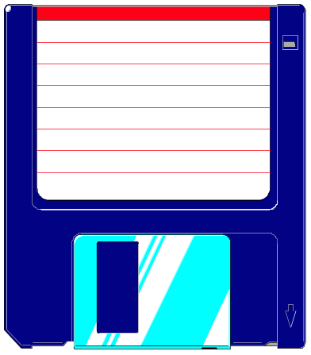
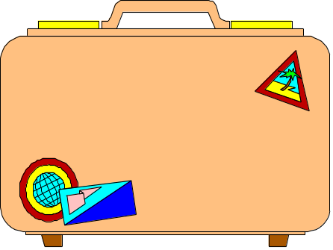
Practical Experience
A practical session will follow each lecture
  All practicals are self-contained
Full model solutions are provided
  You may take away your work and the model solutions
Notes:
Page <number>
WNCOMPG-2 v1.5
Chapter 1, Course Introduction

Slide 7
Contents
1. Course Introduction
2. From C++ to COM
3. COM Fundamentals (Client)
4. COM Fundamentals (Server)
5. Introduction to IDL
6. Building a COM Object Using ATL
7. Strings, Variants and SafeArrays
8. Automation
9. Language Integration
10. Connection points
11. COM EXE Servers
12. Distributed COM Fundamentals
13. Threads & Apartments
14. Introduction to COM+
15. The Way Ahead
Notes:
Page <number>
WNCOMPG-2 v1.5
Chapter 1, Course Introduction

Slide 8

Any Questions?
Ιτ'σ αλλ Γρεεκ το με.
???
Notes:
Page <number>
WNCOMPG-2 v1.5
Chapter 1, Course Introduction

